Slide 1
CEM/
SCEM
CEM/
SCEM
CEM/
SCEM
BPM
AEM
BPM
AEM
BPM
AEM
BPM
-
+
-
-
+
-
-
+
-
-
+
+
+
+
-
+
-
+
-
-
+
-
-
+
-
-
+
+
+
+
-
-
-
-
-
-
-
+
+
+
EC
SWBC
AC
BC
Notes:
Fig. 1

Slide 2
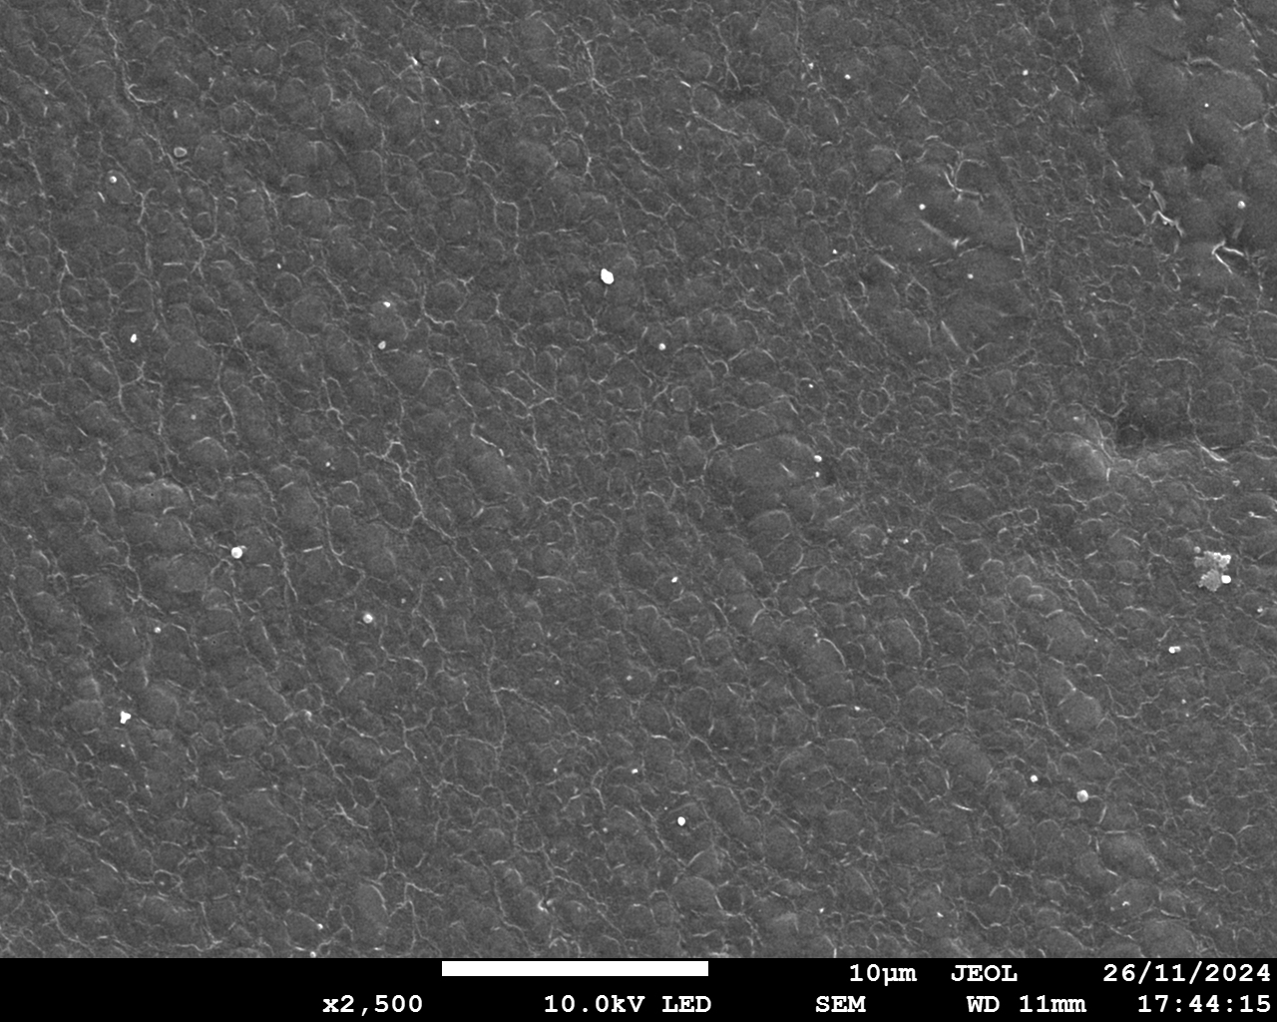
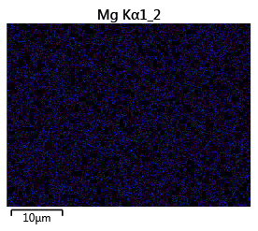
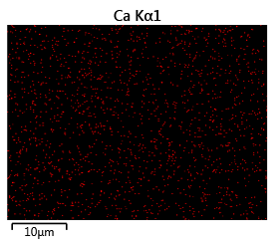
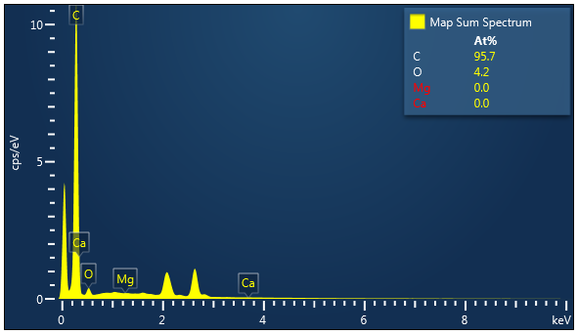
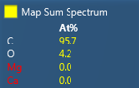
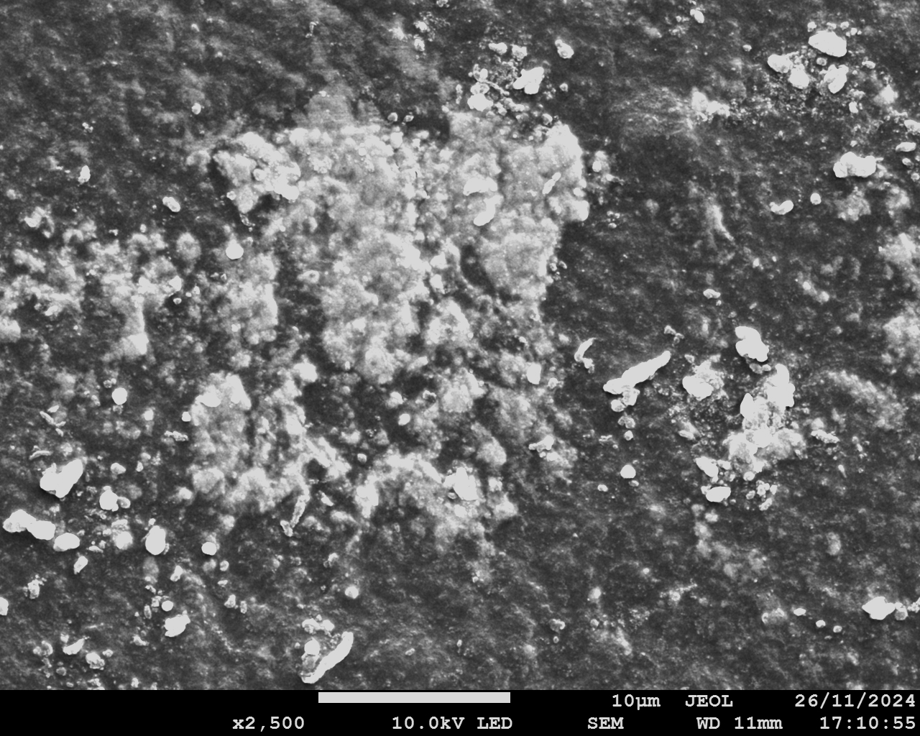
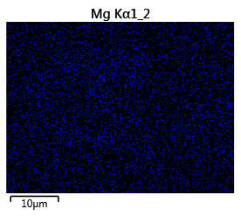
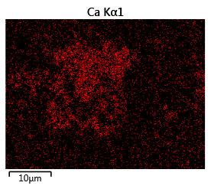
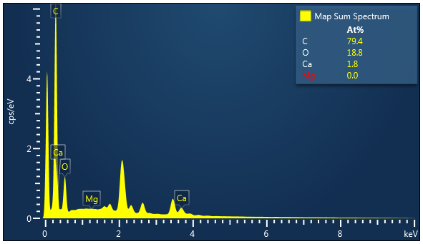
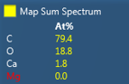
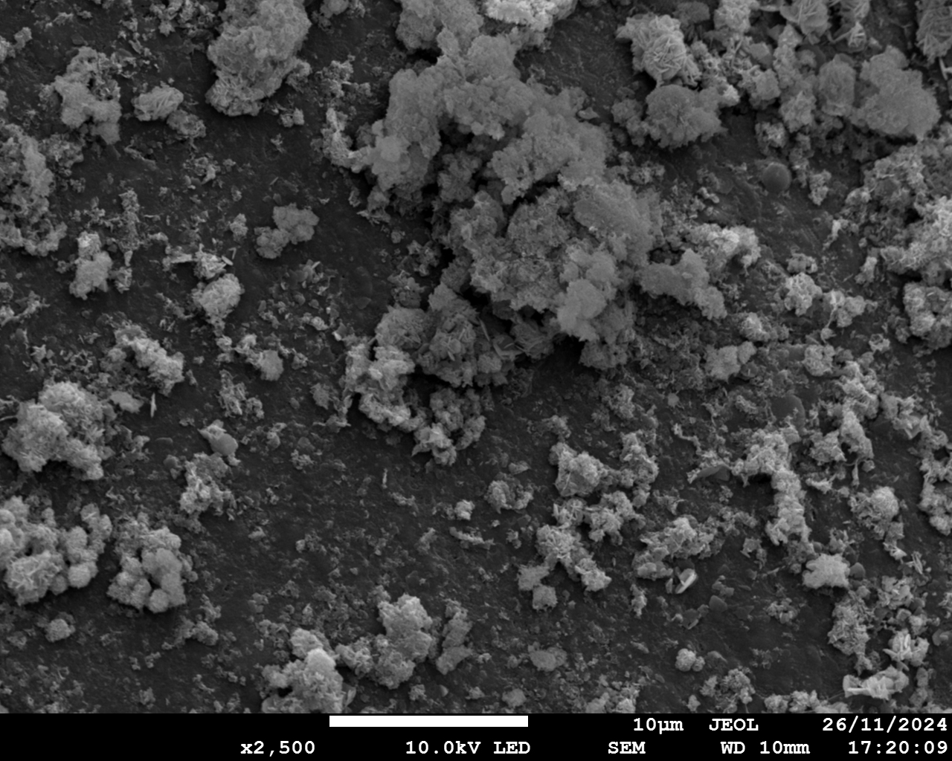
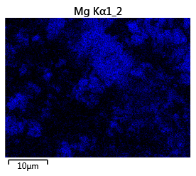
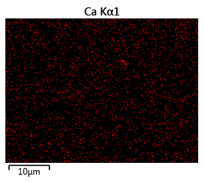
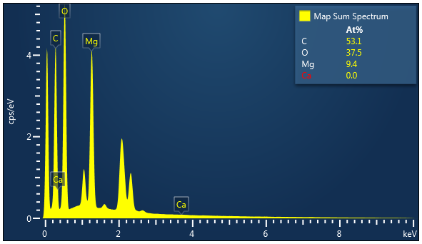
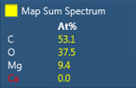
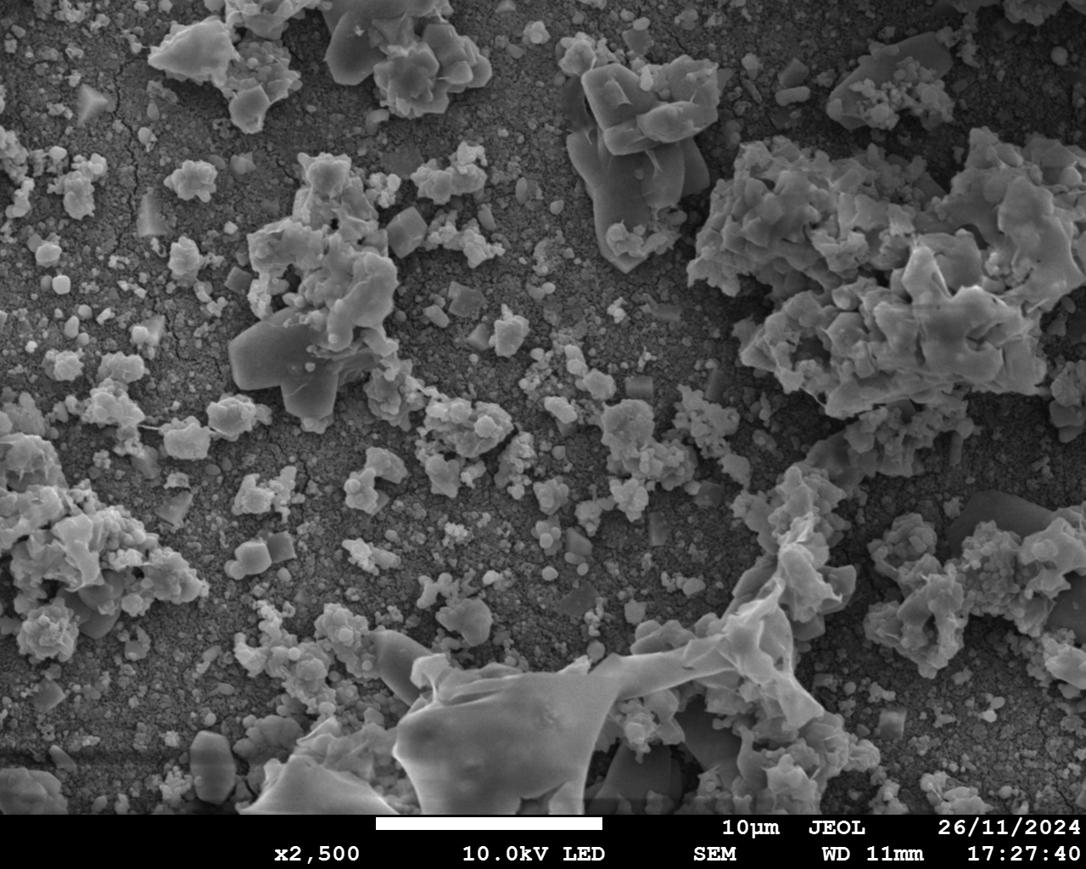
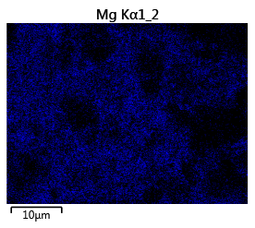
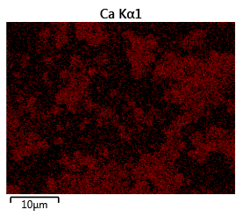
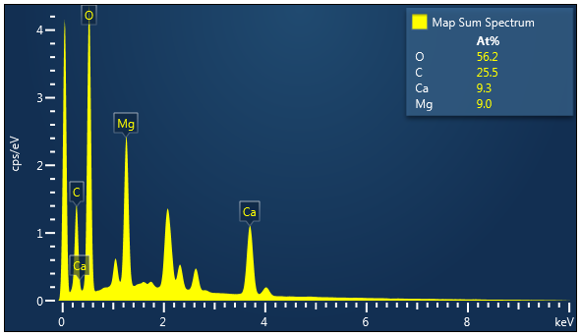
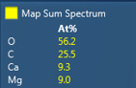
a1
a2
Mg
a3
Ca
a4
10 μm
10 μm
10 μm
b1
b2
Mg
b3
Ca
b4
10 μm
10 μm
10 μm
c1
c2
Mg
c3
Ca
c4
10 μm
10 μm
10 μm
d1
d2
d3
d4
Mg
Ca
10 μm
10 μm
10 μm
Notes:
Fig.2

Slide 3
BPM
AEM
CEM/SCEM
BPM
BPM
EC
AC
+
SWBC
-
BC
EC
-
3
+
OH⁻
Cl⁻
Ca²⁺
+
-
…
+
1
2
-
OH⁻
H⁺
OH⁻
-
OH⁻
H⁺
+
Mg²⁺
Ca²⁺
Na⁺
-
Ca²⁺
Mg²⁺
Na⁺
+
+
-
1
2
3
Scaling on CEM/SCEM
facing SWBC
Scaling on CEM/SCEM
facing BC
Scaling on BPM
facing BC
Scaling: Mg(OH)₂
The leakage of OH⁻
Scaling: Mg(OH)₂, Ca(OH)₂, CaCO₃
The transport of Mg²⁺/Ca²⁺
Scaling: Ca(OH)₂
The transport of Mg²⁺/Ca²⁺

Slide 4
Notes:
Fig.2 Ca, Mg reduction ratio and scaling; Acid/base/salt chamber 中 Ca Mg concentration change.

Slide 5
a
b
c
d
e
Notes:
Fig.3

Slide 6
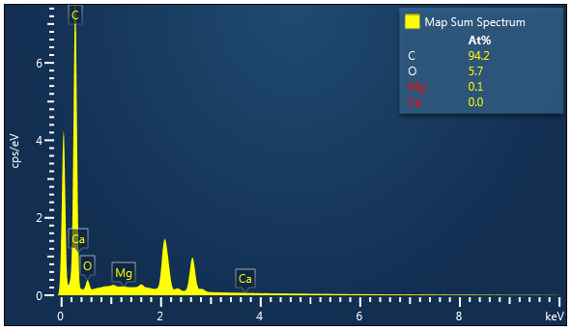
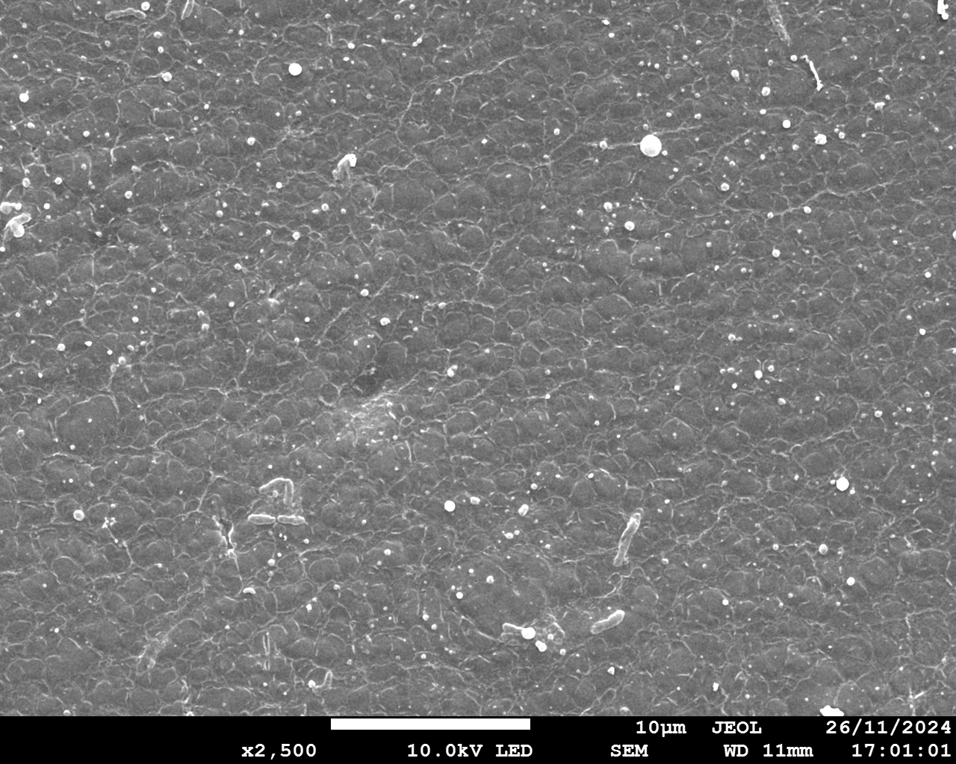
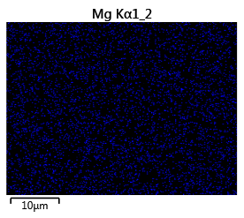
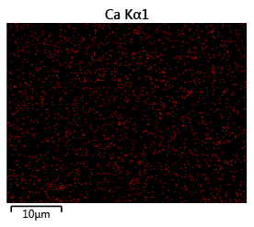
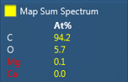
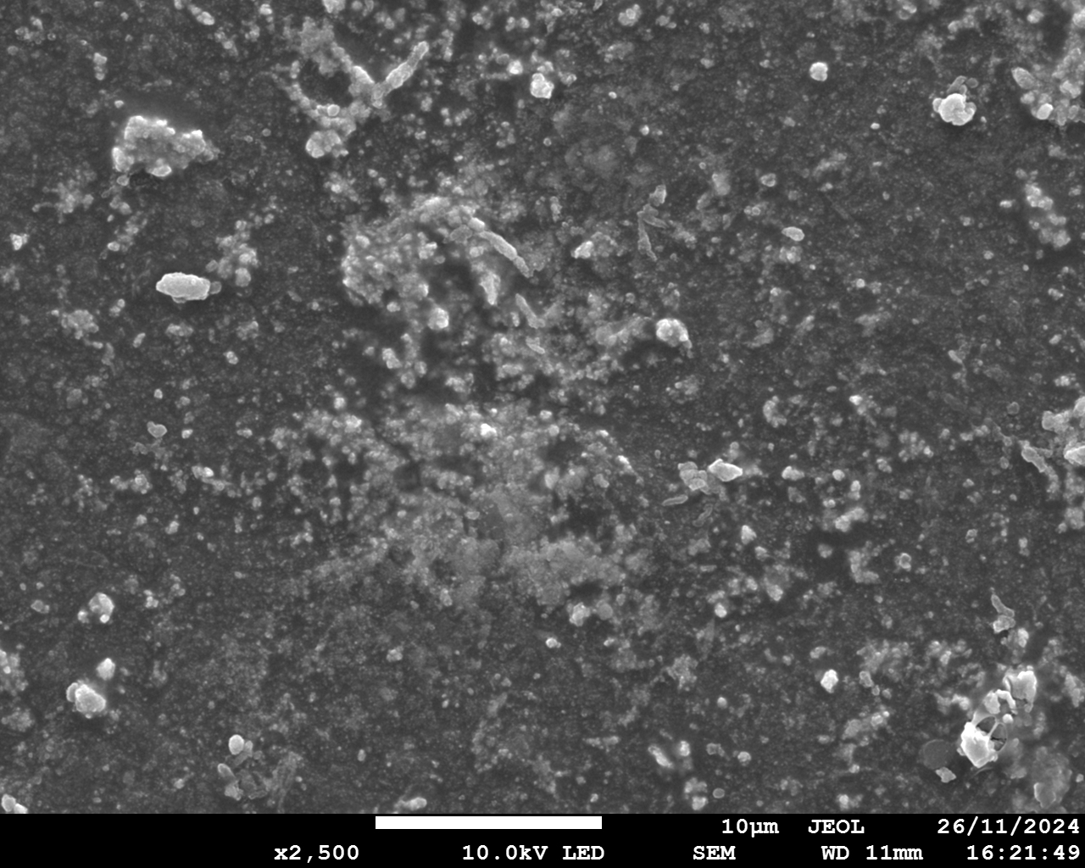
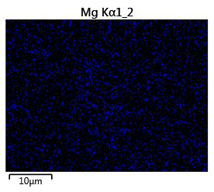
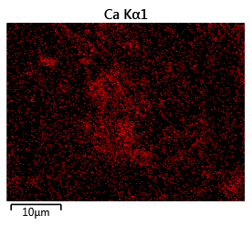
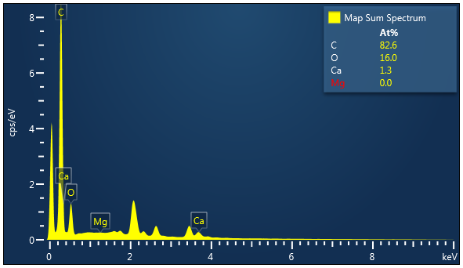
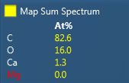
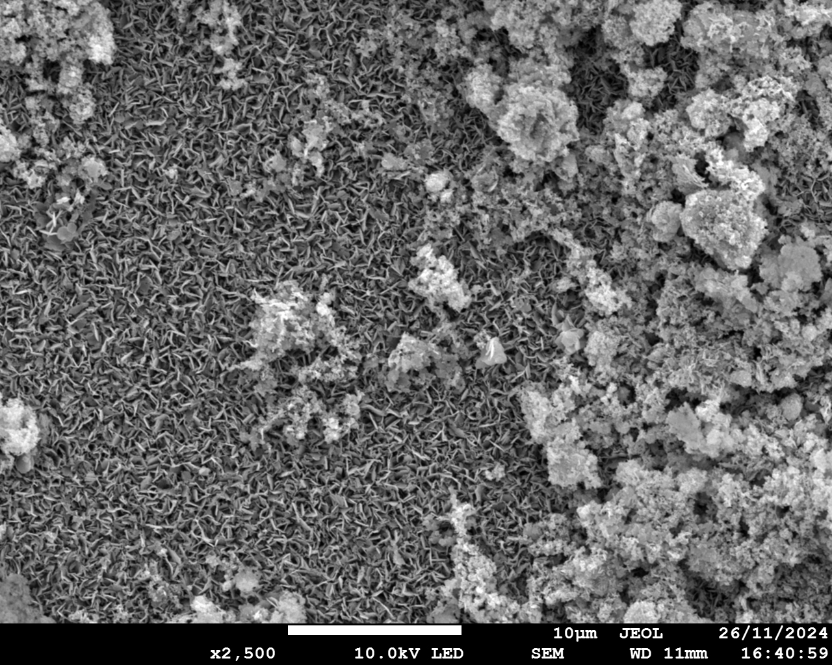
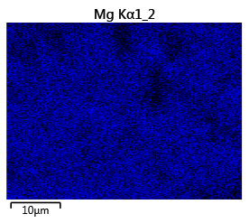
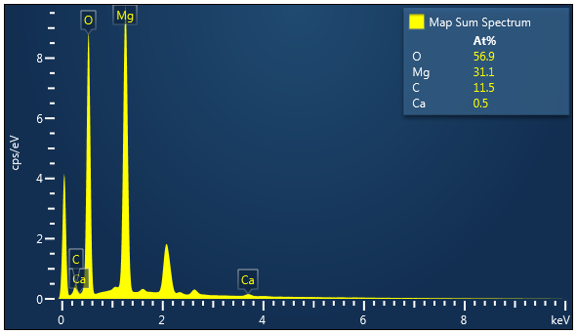
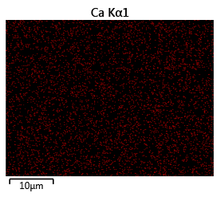
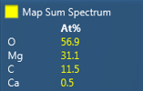
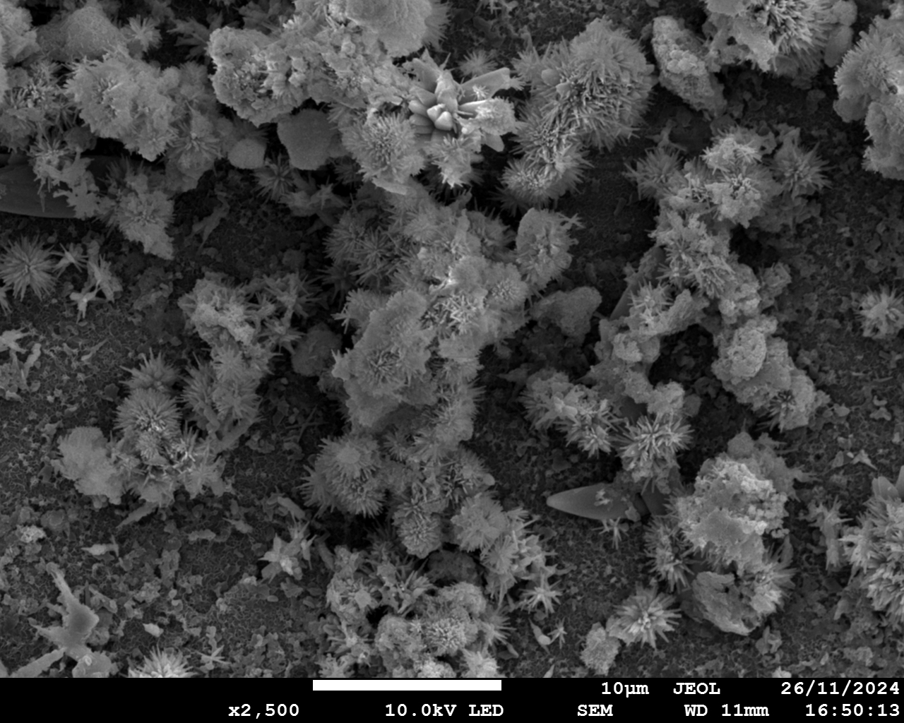
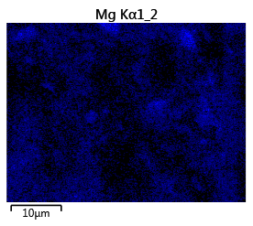
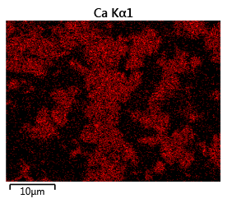
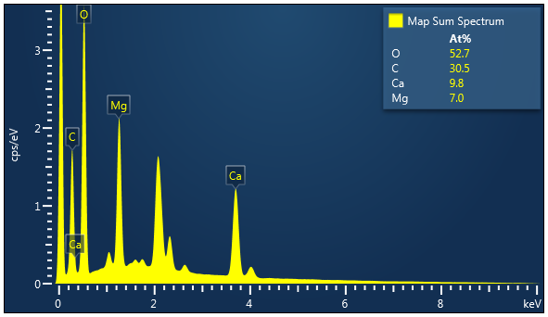
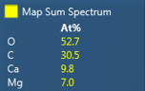
a1
a2
Mg
a3
Ca
a4
10 μm
10 μm
10 μm
b1
b2
b3
b4
Mg
Ca
10 μm
10 μm
10 μm
c1
c2
Mg
c3
c4
Ca
10 μm
10 μm
10 μm
d1
d2
d3
d4
Mg
Ca
10 μm
10 μm
10 μm
Notes:
Fig.5

Slide 7
Notes:
Fig.5

Slide 8
a
b
c
e
d
Notes:
Fig.6

Slide 9
a
b
Notes:
Fig.8

Slide 10
a
b
c
d
e
Notes:
Fig.9

Slide 11
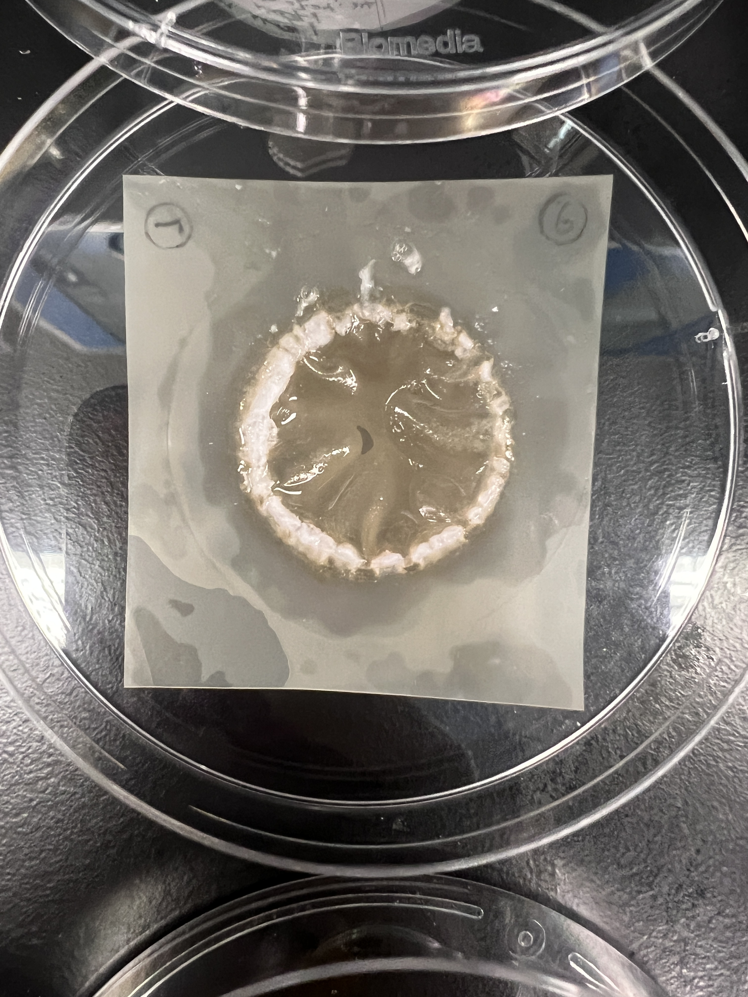
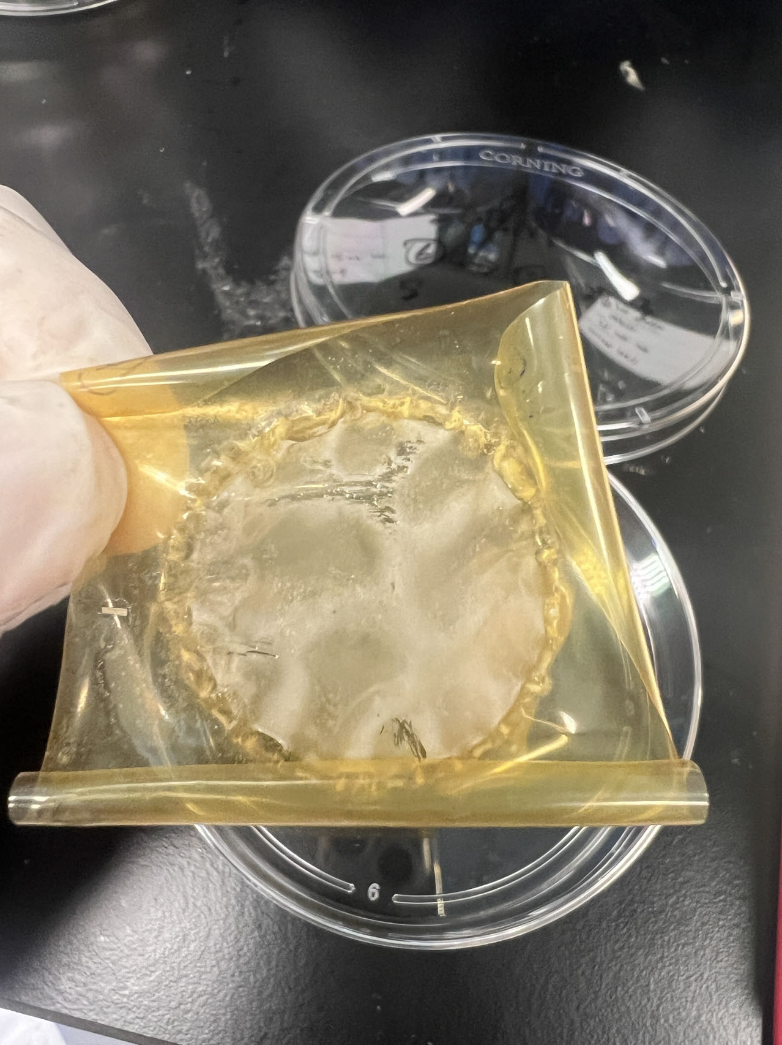
Notes:
S1

Slide 12
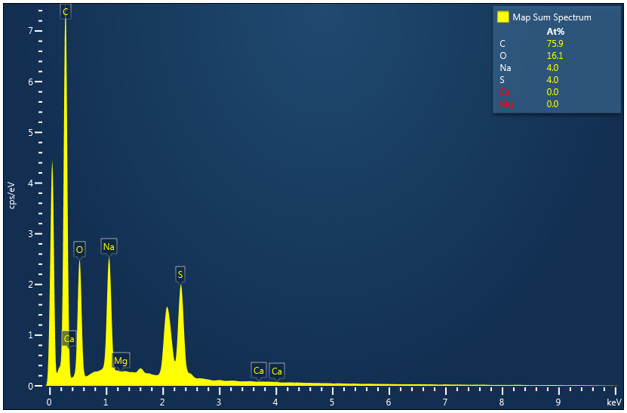
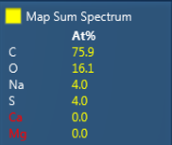
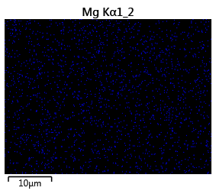
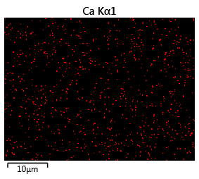
a
b
10 μm
c
Mg
d
Ca
10 μm
10 μm
Notes:
S2

